Slide 1


Permitted Transactions

Slide 2
Card Present Transaction (CP)
A card-present (CP) transaction occurs when payment details are captured in person for a product or service. This can include cards that are physically swiped via a card reader machine or tapped or dipped via a card reader.
Examples of Card-Present Transactions:
The customer’s card is swiped into a card reader device via the magnetic card strip.
The customer’s card is inserted into a card reader device via the EMV chip.
The customer’s mobile wallet (electronic data) is captured via a contactless POS.

Slide 3
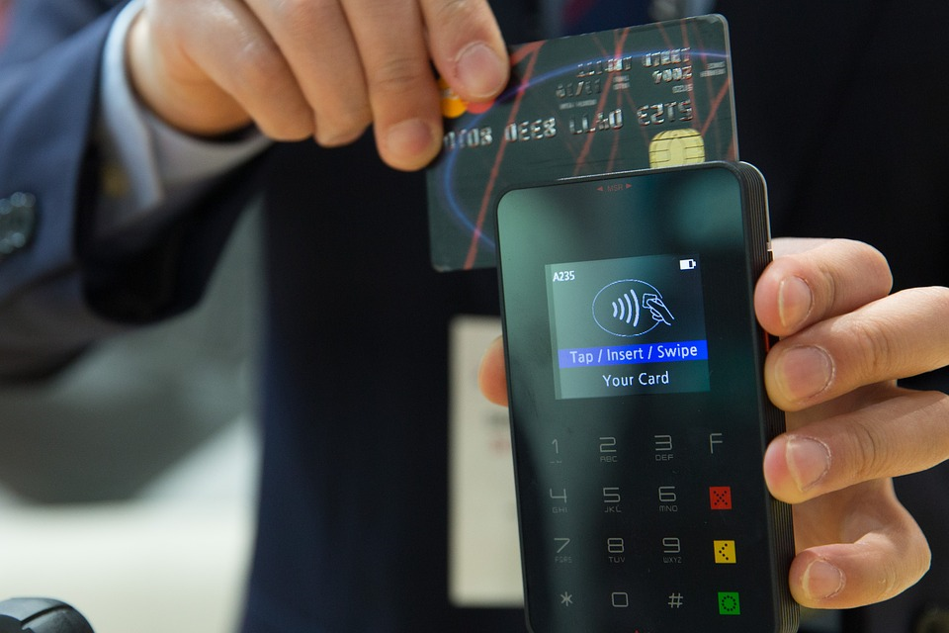
Card Present Transaction (CP)
Advantages
Reduced Fraud Risk
Faster Processing:
Instant Verification
Lower Processing Fees
Customer Confidence
Less Chargeback Risk
Immediate Receipt
Availability in Remote Areas
Simplified Checkout
Offline Processing
Disadvantages
Equipment Costs
Physical Card Dependency
Less Convenient for Customers
Geographical Limitations

Slide 4
Card-not-present (CNP) transaction
A card-not-present (CNP) transaction typically occurs when the cardholder and credit card are not physically present during a purchase. Customers usually manually enter card information for CNP transactions rather than capturing the card details through a secure card machine. This usually includes remote methods, such as via phone, mail, fax, or online.
Examples of Card-Not-Present Transactions:
The customer enters their card details via an online payment system (e.g., ecommerce site or app).
The customer fills out their card details on a paper form and sends it via mail or fax to a business.
The customer shares their card information over the phone.
The customer gives their credit or debit card to a merchant, who enters the card details manually.
The customer provides their card information for recurring billing services (e.g., monthly gym membership or fresh food deliveries).

Slide 5
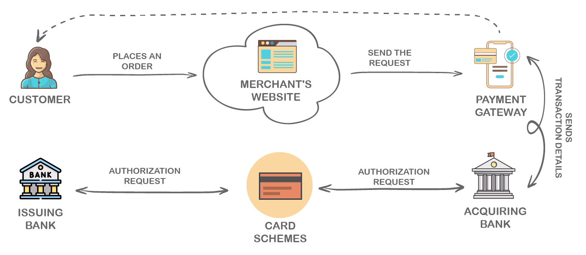
Card-not-present (CNP) transaction

Slide 6
Card Not Present Transaction (CNP)
Advantages
Convenience for customers
Global Reach
Less Infrastructure Needed
Easy Integration
Well-suited for Subscription and Recurring Payments
More Data Collection and Analysis For Business
Accessibility for 24/7
Disadvantages
Higher Fraud Risk
Higher Payment Processing Fees
More Payment Declines
More Chargeback Risk
Customer Identity Theft
Complex Security Measures
Limited Offline Access
Return and Refund Complexity

Slide 7
Authorization

Slide 8
Authorization
Authorization has mainly two parts:
Authorization request In the context of card payments, an authorization request refers to the process of obtaining approval from the cardholder's issuing bank (also known as the issuer) to complete a payment transaction.
Authorization response
An authorization response is the message sent back from the cardholder's issuing bank (or issuer) to the merchant's point-of-sale (POS) system or online payment gateway after an authorization request has been submitted. The authorization response contains information about whether the transaction is approved, declined, or requires further action.

Slide 9
Steps For Authorization Request
Initiation of Transaction
When a cardholder makes a purchase using their credit or debit card, the merchant's point-of-sale (POS) system or online payment gateway initiates the transaction.
2. Authorization Request
The merchant's system sends an authorization request to the cardholder's issuing bank through the payment network (such as Visa, Mastercard, etc.). This request includes important transaction details, such as the card number, transaction amount, merchant information, and the transaction type (e.g., purchase, refund, etc.).
3. Issuer reception
The cardholder's issuing bank receives the authorization request.

Slide 10
Authorization Request Flow
MTI 1100/0100/1200/0200 MTI 1100/0100/1200/0200
Merchant terminal Acquirer bank Network
MTI 1100/0100/1200/0200
Issuer Bank

Slide 11
Steps For Authorization Response
Issuer Verification
The cardholder's issuing bank receives the authorization request and processes it. The bank verifies the card's validity, checks for available funds or credit, and assesses whether the transaction aligns with the cardholder's spending patterns and any fraud detection algorithms.
2. Generation of Authorization Response
Based on the analysis of the authorization request, the issuing bank generates an authorization response. This response is then sent back to the merchant's system through the payment network.
Authorization Response Content
The authorization response contains several key pieces of information.

Slide 12
Authorization Response Flow
MTI 1110/0110/1210/0210 MTI 1110/0110/1210/0210 MTI 1110/0110/1210/0210
Issuer Bank Network Acquirer bank
Merchant terminal

Slide 13
Steps For Authorization Response
4. Merchant System Processing
Upon receiving the authorization response, the merchant's system processes the information. If the transaction is approved, the merchant can proceed to complete the transaction. If the transaction is declined, the merchant informs the cardholder that the payment was not successful.
5. Transaction Completion or Adjustment
If the transaction is approved, the merchant finalizes the sale, and the authorized funds are transferred from the cardholder's account to the merchant's account. If there were adjustments (e.g., adding a tip), the final transaction amount might be different from the authorized amount.
Upon receiving the authorization response, the merchant's system processes the information. If the transaction is approved, the merchant can proceed to complete the transaction. If the transaction is declined, the merchant informs the cardholder that the payment was not successful.

Slide 14
Steps For Authorization Response
6. Transaction Completion or Adjustment
If the transaction is approved, the merchant finalizes the sale, and the authorized funds are transferred from the cardholder's account to the merchant's account. If there were adjustments (e.g., adding a tip), the final transaction amount might be different from the authorized amount.

Slide 15
Authorization Response Contents
Approval Code
If the transaction is approved, the response includes an approval code. This code is a confirmation that the issuing bank has authorized the transaction to proceed.
Decline Message
If the transaction is declined, the response includes a decline message that provides a brief reason for the decline. This could be due to insufficient funds, suspicious activity, or other reasons.
Further Action Required
In some cases, the response may indicate that further action is required. For instance, the response might indicate that the transaction requires cardholder verification, such as entering a PIN, or additional authentication through a one-time password (OTP).

Slide 16
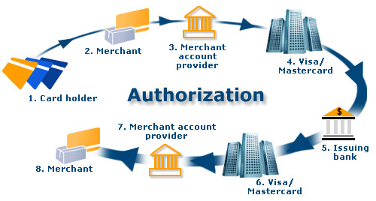
Complete Authorization Flow

